Slide 1
Label Generation and Zebra Programming Language (ZPL) for Manhattan SCALE™
Jake Reid
Consultant – PSO

Slide 2
Slide Contents
Basic label introduction
Label Types
Document Configurations
ZPL
Examples
Resources

Slide 3
Custom Label Generation with SCALE 2021

Slide 4
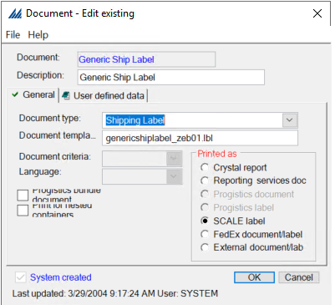
Document Configuration
The document field represents the document that you want the system to produce. All documents must be defined in the system under “document”.

Slide 5
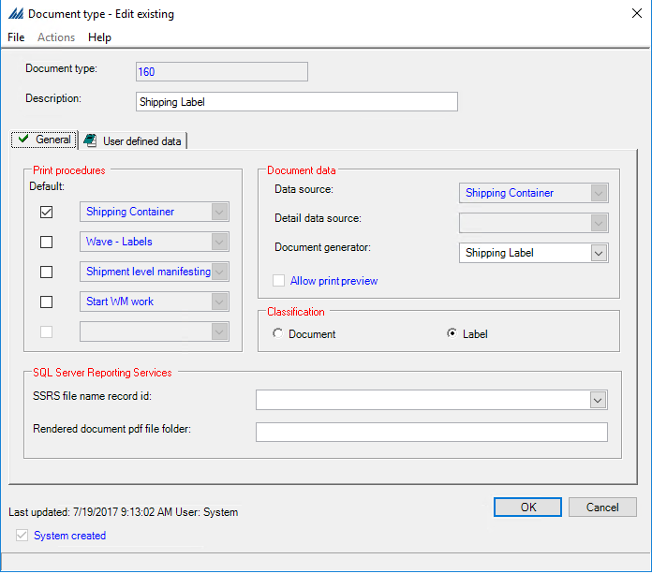
Document Type Configuration
Identifies the document as either a paper or label document. The document type required can be ‘shipping’ or ‘vendor’ for custom labels. All documents must be associated with a document type located under “document type” within configurations.

Slide 6
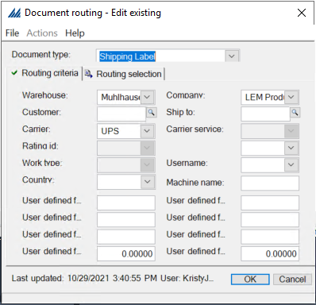
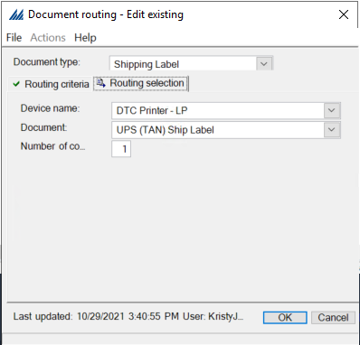
Document Routing Configuration
After you define a document, you need to provide its printing parameters on the Document Routing Window. The print parameters determine criteria such as: Ship to, Carrier, Container Class. Additionally, the routing determines number of copies, where the document is routed to, which document will be used, and what machine the document will print from.

Slide 7
Label Generation Requirements
Label file
  Saved in the Manhattan install files - \ILS\Printing
Stored Procedure (some labels)
Document Type Configuration
Document Configuration
Document Routing Configuration
Wave Step: Documents – Labels (If printing during wave)
Label Printer – must be compatible with 203dpi
Notes:
Commonly used for interface error alerts or delete shipments.

Slide 8
Label Types
Vendor Label
Shipping Label
Container Contents Label
Break Label
Receipt Container Label
Notes:
Commonly used for interface error alerts or delete shipments.

Slide 9
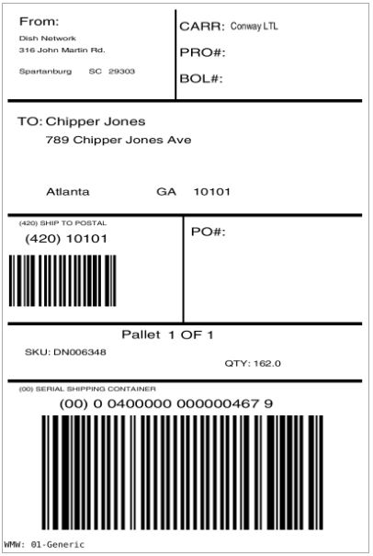
Vendor Label
A vendor compliant label is a container identification label that is compliant with the ship to's specifications.
If you would like to print both a container contents label and a vendor compliant label from the wave, see the topic Container Contents & Vendor Labels.
Printers producing vendor compliant labels must be accessible through a network share. Please refer to the Printer Configuration Guide for more information.

Slide 10
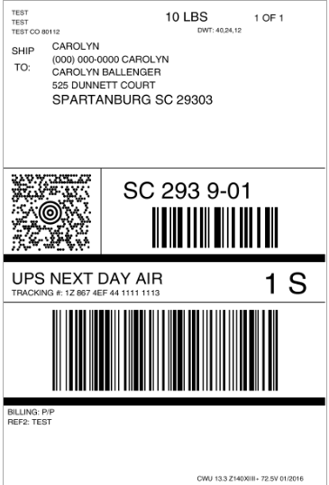
Shipping Label
A shipping label is used for carrier shipping purposes to identify a shipping container. It includes ship from and ship to information. The system automatically generates shipping labels during container packing and container manifesting. Note that if the shipping container is associated with a company, the system uses the company's name and address as the ship from values on this label.
Notes:
NOTE** Show Carrier EDI Reference field configs

Slide 11
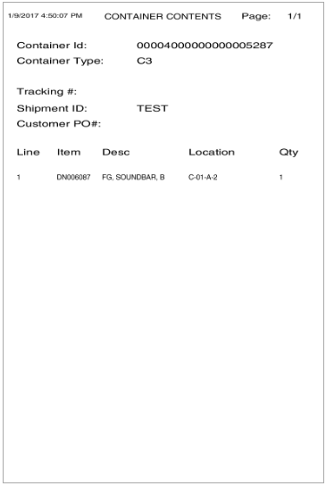
Container Contents Label
A container contents label identifies the items packed into a specific container. This label also includes such data as the item location, quantity, and basic shipment information. Container contents labels can be automatically printed during the container creation wave step. You can also manually print this label in the Shipping Container Insight (once the container has been packed).

Slide 12
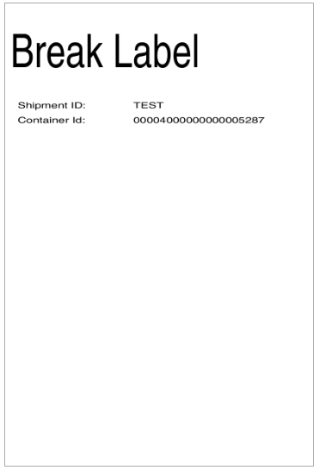
Break Label
Select the “Break Label” checkbox to indicate that you want the system to print a break label between shipments' labels in a wave.
Separated label when printing out a series of labels
Break Conditions
Split at predetermined level the break label provides a marker between batches of labels.

Slide 13
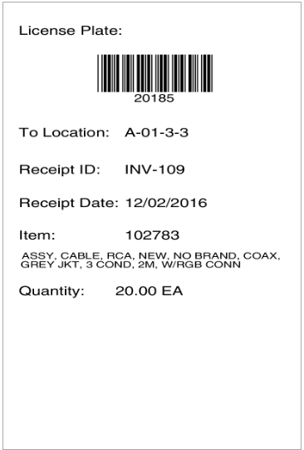
Receipt Container Label
A receipt container label is the equivalent of a vendor label for inbound receipt container printing
Notes:
Prints during Locating

Slide 14
Stored Procedure Add-Ins

Slide 15
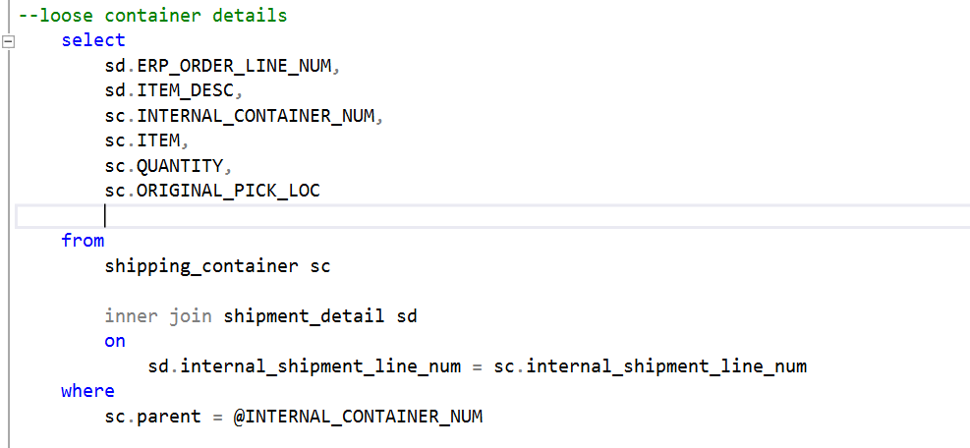
Shipment Detail
Within the database (accessible through SSMS) under “programmability’
These are the fields that can be custom added to the Shipment Detail Label:

Slide 16
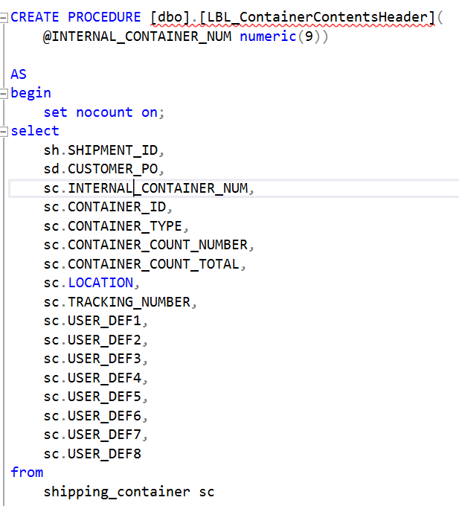
Container Contents Header
Within the database (accessible through SSMS) under “programmability’
  Programmability>>>
The following fields can be added to the Shipment header:

Slide 17
Adding a vendor label file to the system

Slide 18
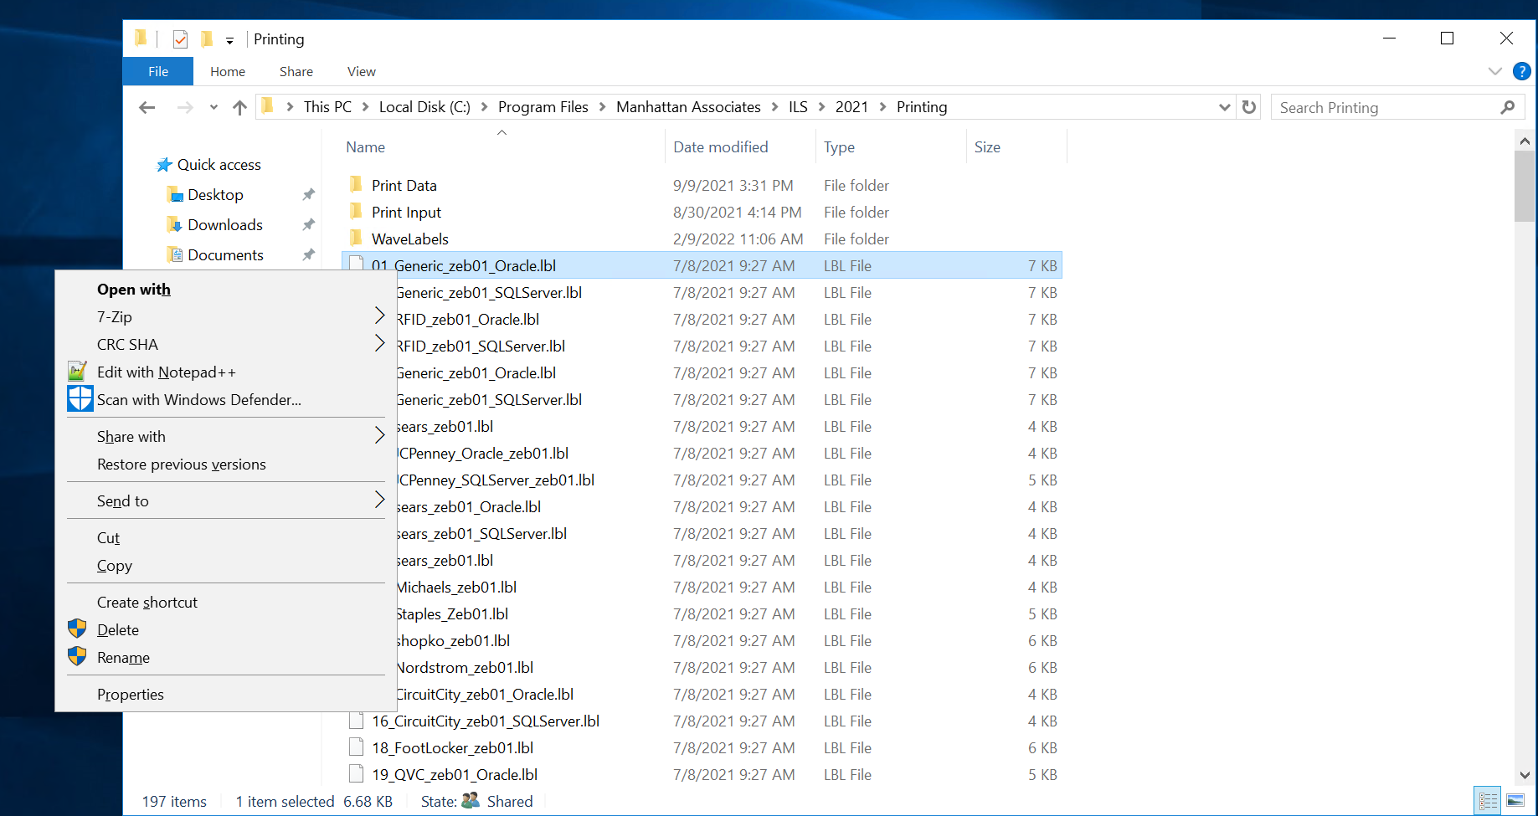

Navigate to printing within the system
C:\Program Files\Manhattan Associates\ILS\2021\Printing
Copy an existing .lbl – Paste the copy and rename according to the name of the vendor the template is being created for.

Slide 19
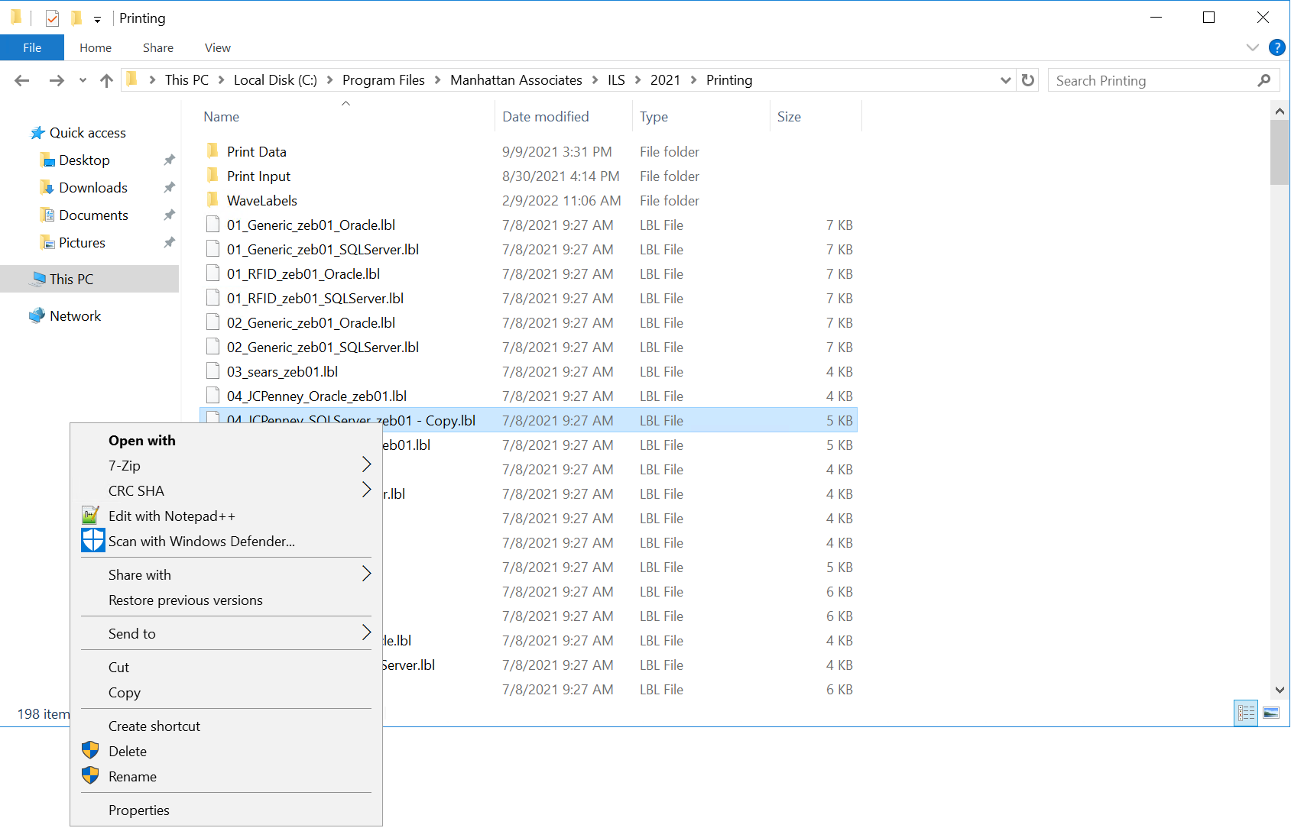

Update the file with custom ZPL
After creating the new file input the ZPL formatting for the specific label.
  Choose to edit with notepad++, then completely replace the contents and save the file.

Slide 20
Zebra Programming Language (ZPL)

Slide 21
What Is ZPL?
Zebra Programming Language
ZPL is a print language used by many label printers. It is primarily used for labeling applications.
ZPL can be used to design label templates, as well as pull data from a SQL database.
Notes:
Commonly used for interface error alerts or delete shipments.

Slide 22
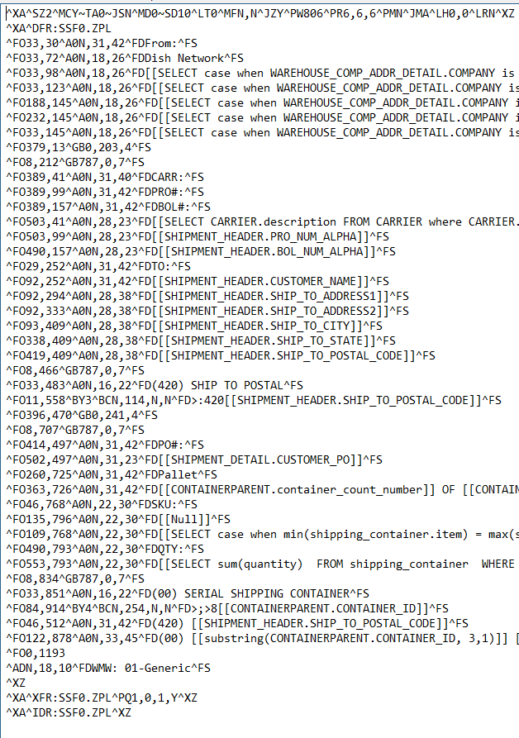
ZPL Command Basics
^XA – Start Format
^XZ – End Format
^FOx,y – field origin
  X – x coordinate
  Y – y coordinate
^FS – field separator
^A0NX,Y – font size
  X – width
  Y – height
^FD – field data
^B% - barcode fonts
  Bx, Bc, Bo, Bq, B3
^GB – graphic box

Slide 23
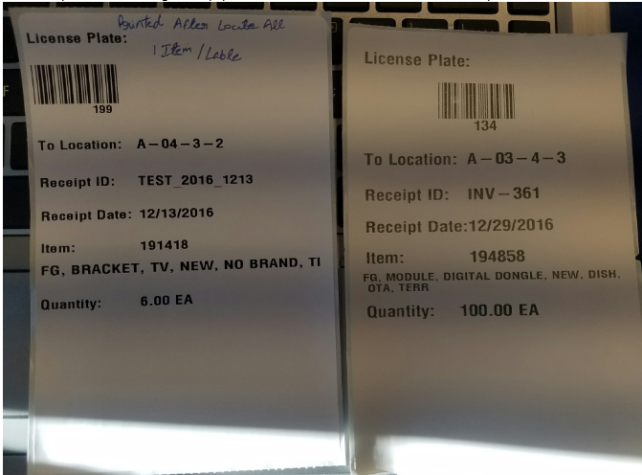
Other Commands
Wrap Text
  ^FB800,4,,,15
  ^A0N,30,40^FD [[RECEIPT_DETAIL.ITEM_DESC]]^FS

Slide 24
Other Commands
Print Speed
  ^PR – sets print rate to a value that you specify
    ^PR12 vs ^PR8
Darkness
  ~SD – sets darkness to a value that you specify
  ^MD– adjusts the darkness relative to the current setting
    Note: The ^MD is persistent across label formats until an new ^MD command is issued or the printer power is cycled.
Orientation
  ^FW – sets the default orientation for command fields
    ^FWr
      R = rotate field;
        N = normal, R = 90 degrees, I = 180 degrees, B = bottom-up 270 degrees

Slide 25
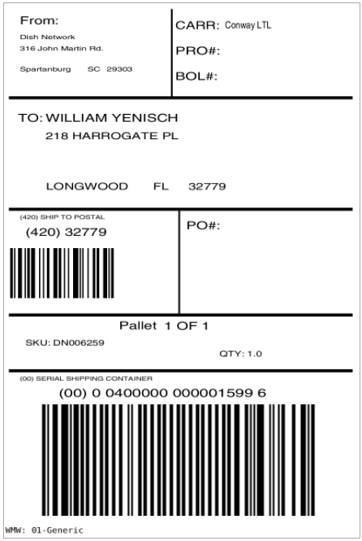
Example 1 Vendor Label: Font Size, Field Positions, Data Fields
Client would like for us to make the following changes to this label:
  Add the Customer Item Number from Shipment Detail below SKU.
  Increase the font size of the Ship From information
  Center the Postal Code Barcode

Slide 26
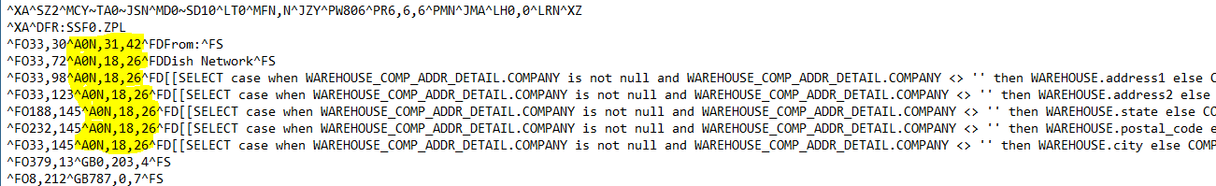
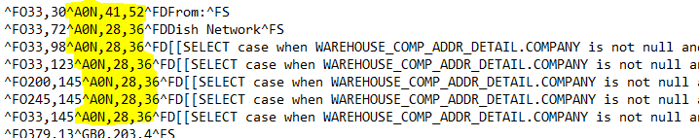
Example 1 Vendor Label: Increase Font Size

Slide 27


Example 1 Vendor Label: Center Barcode

Slide 28
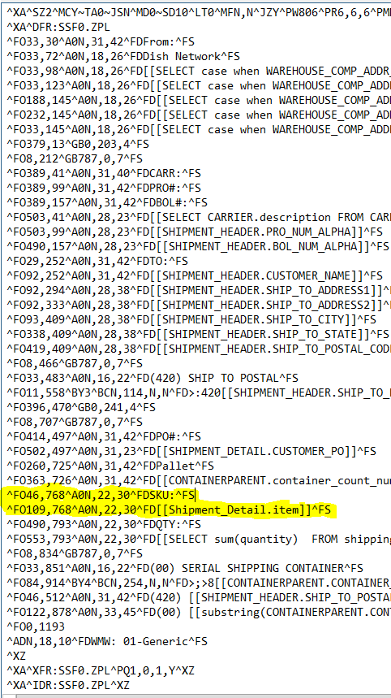

Example 1 Vendor Label: Add Data Field

Slide 29
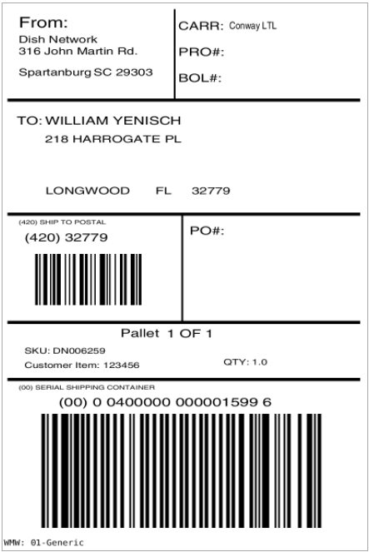
Example 1: Before and After

Slide 30
SQL in ZPL
Case Statement
[[SELECT CASE WHEN min(shipping_container.item) = max(shipping_container.item) THEN [[SHIPMENT_DETAIL.ITEM]] ELSE 'MIXED PALLET' END FROM SHIPMENT_DETAIL, SHIPPING_CONTAINER WHERE SHIPMENT_DETAIL.INTERNAL_SHIPMENT_LINE_NUM = SHIPPING_CONTAINER.INTERNAL_SHIPMENT_LINE_NUM AND]] ^FS
Right Trim
[[SELECT left(customer_po, len(customer_po) -5) FROM SHIPMENT_DETAIL, SHIPPING_CONTAINER WHERE SHIPMENT_DETAIL.INTERNAL_SHIPMENT_LINE_NUM = SHIPPING_CONTAINER.INTERNAL_SHIPMENT_LINE_NUM AND]] ^FS

Slide 31
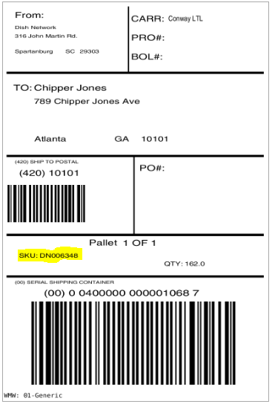
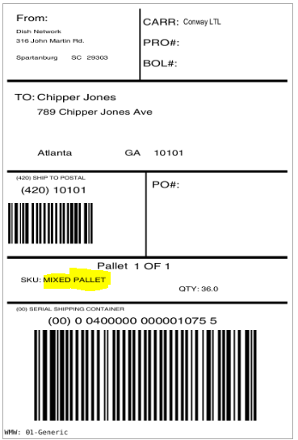
Case Statement Examples

Slide 32
Client Cases

Slide 33
Client Case 1: Dish Break Label and Container Contents Label
Requirement: “We want to build our carts by container type. We want our labels for parcel shipments to be grouped by container type while printing and we need to know how many of each container type will be used. The users will be handed a stack of labels, starting with the break label, which will tell them how many of a specific container type are needed. Then, they find the container types and then put them on a cart for picking. We also need the Container ID barcoded.”
Resolution: We can configure our Label Master criteria to order our labels by Container Type, and can stamp the Container Type and count on Break Labels. We can have a Break Label print for every Container Type. We will add a barcode to the top of the container contents label for the Container ID.

Slide 34
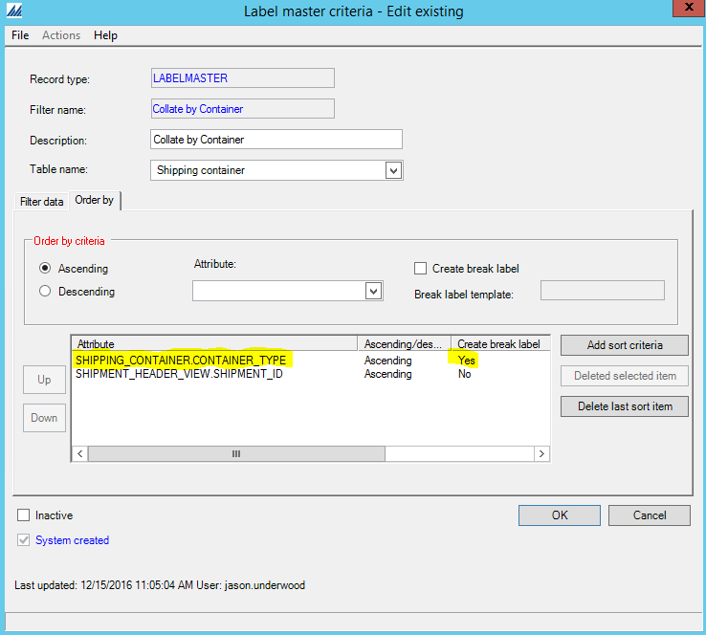
Client Case 1: Dish Label Master Criteria

Slide 35
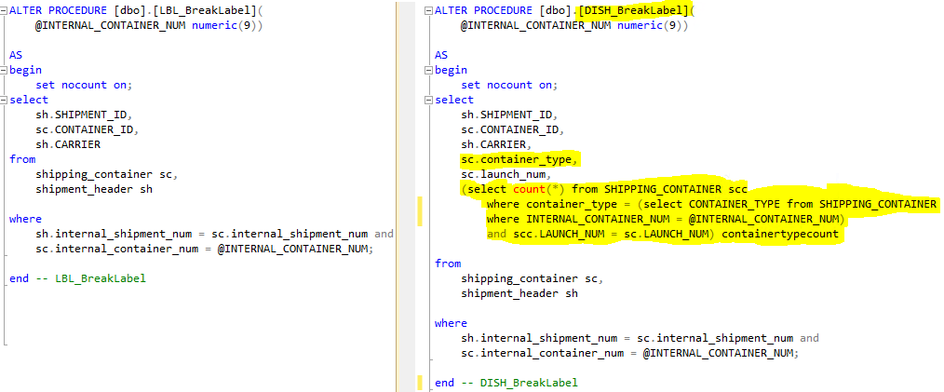
Client Case 1: Dish Break Label Stored Procedure

Slide 36
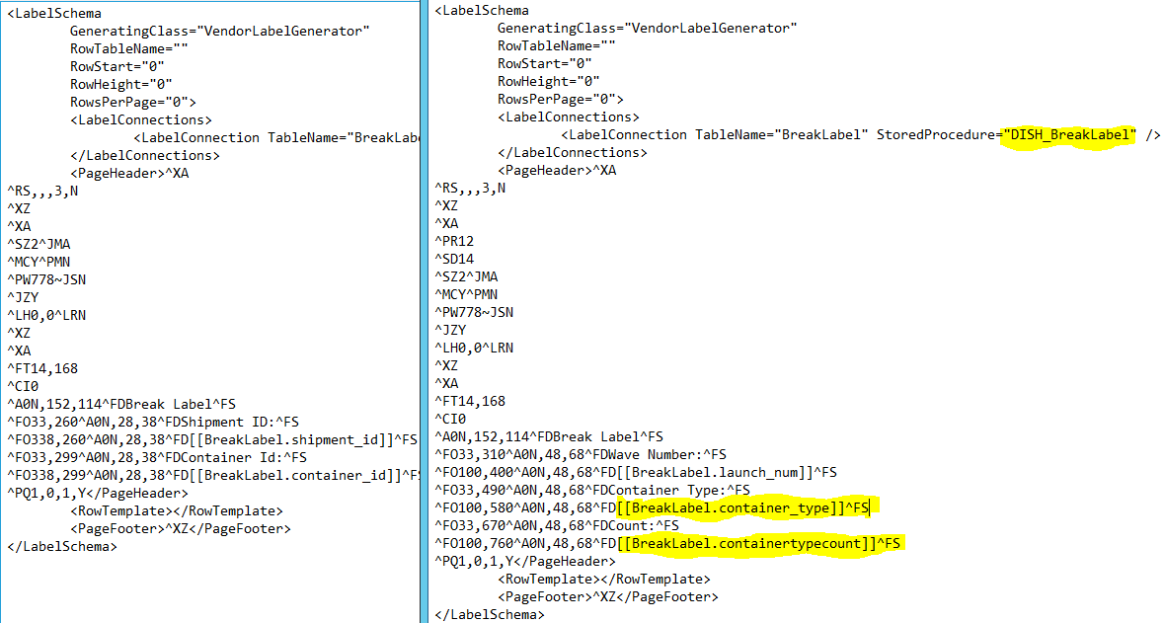
Client Case 1: Dish Break Label ZPL

Slide 37
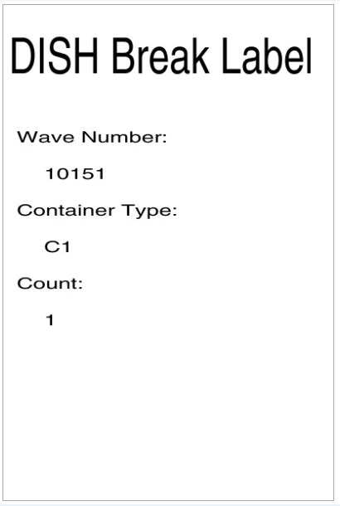
Client Case 1: Dish Break Label Example

Slide 38
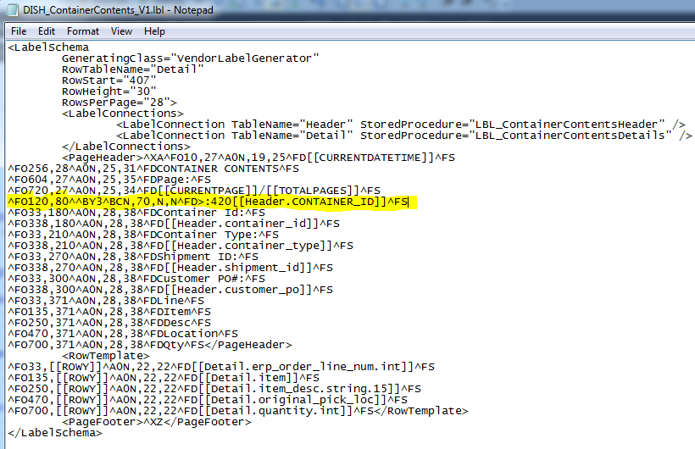
Client Case 1: Dish Container Contents Label ZPL

Slide 39
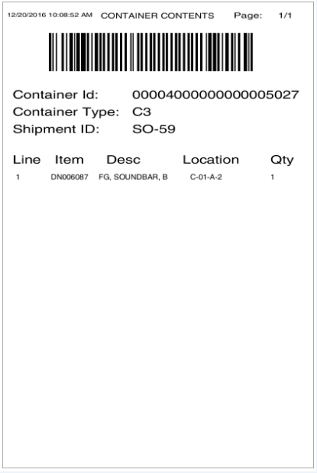
Client Case 1: Dish Container Contents Label Example

Slide 40
Client Case 2: Keeco LL Bean Vendor Label
Requirement: LL Bean requires a custom vendor label with very specific guidelines. They are not a top 100 retailer, so Manhattan does not have the label developed. The client asked the PSO team to assist with development.
Resolution: Use the generic vendor label as a template and then edit it to match the requirement. Use the ^GB command to draw out the lines needed on the label and then input the necessary field commands.

Slide 41
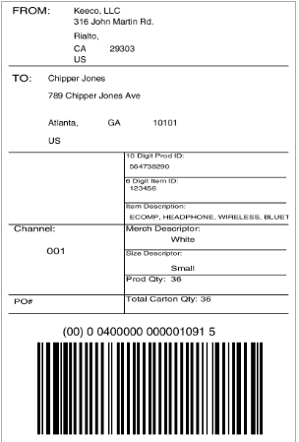
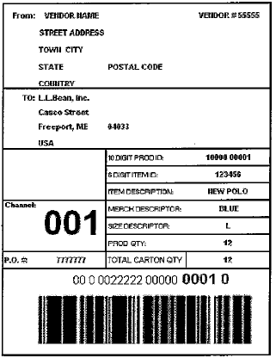
Client Case 2: Keeco LL Bean Vendor Label

Slide 42
Client Case 3: Dish Customer Returns Label
Requirement: Dish needs an LPN label for each item that is returned. The items are small, so they need a 2x3 version of the receipt container label to print during check in. The label needs to print horizontally as well.
Resolution: Use label lary to format the label with a 2x3 size, and use the ^FW command to rotate the label 90 degrees.

Slide 43
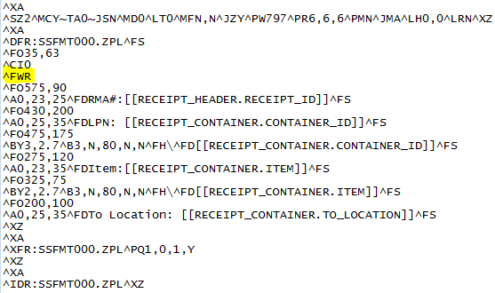
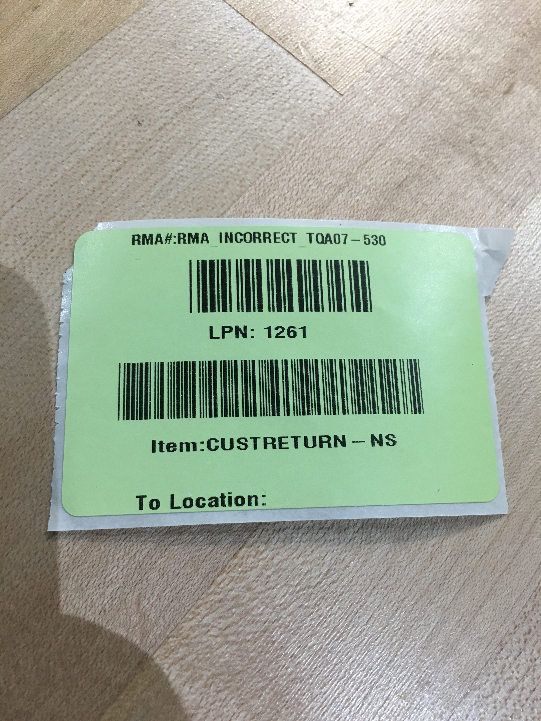
Client Case 3: Dish Customer Returns Label

Slide 44
Resources for Editing ZPL Labels
Label File Directory: C:\Program Files\Manhattan Associates\ILS\2016\Printing
Spool File: C:\Windows\System32\spool\PRINTERS
Labelary: http://labelary.com/
Wave Label File: C:\Program Files\Manhattan Associates\ILS\2021\Printing\WaveLabels
  .WLI file – document type, printer, number of copies, errors, etc.
  .WLD file – zpl output
ZPL Programming Guide: https://www.zebra.com/content/dam/zebra/manuals/en-us/software/zplii-pm-vol1.pdf

Slide 45
Summary

